Slide 1
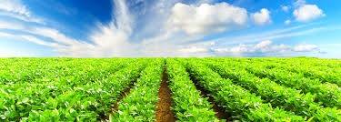
How Agricultural industry overcame Covid-19 impacts using controlling methods

Slide 2

Covid-19
The tiny thing that shook the world

Slide 3
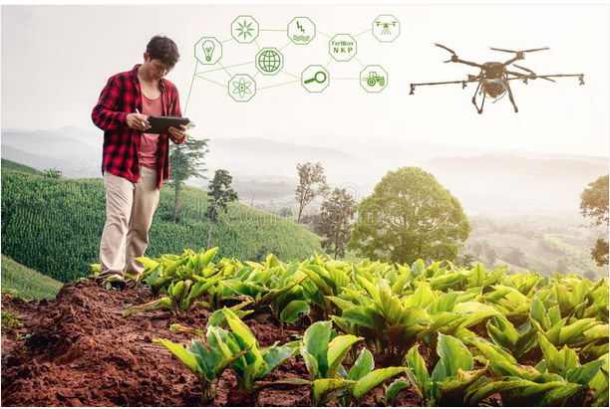
Agricultural Industry
where human resilience and ingenuity
overcame the Covid-19 impacts
USD 5.4 billion growth already
and projected to increase!

